Slide 1
U.S. FDA Data Analysis
Presented by:
Akash Rathi
ABADS-8A

Slide 2
Business Objective
To create informative reports by conducting a thorough analysis of the FDA’s data using powerful tools like MySQL and Power BI.

Slide 3
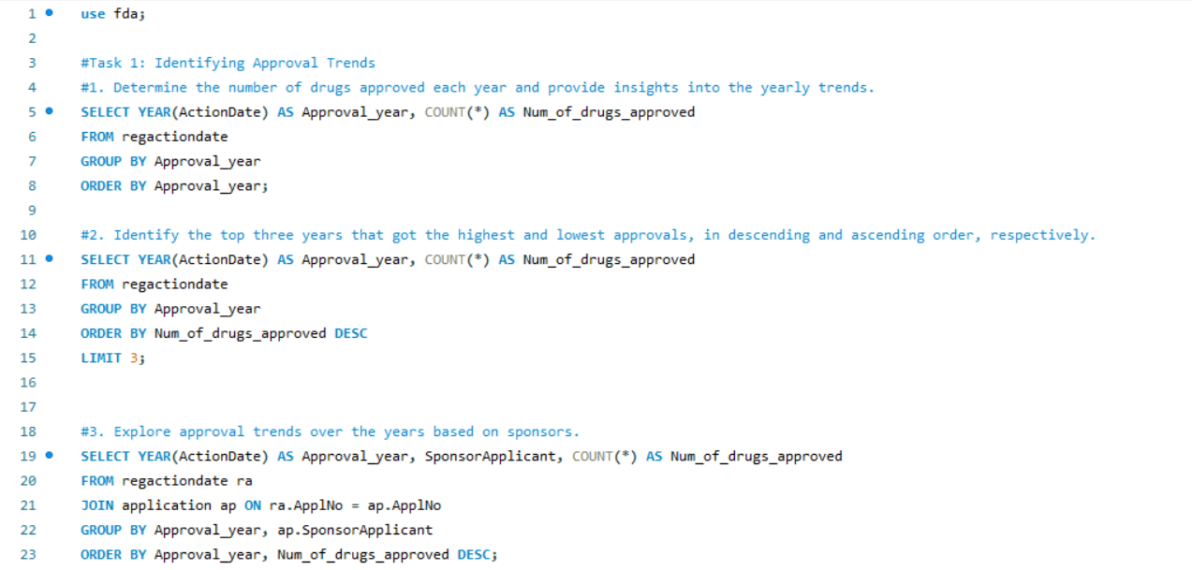
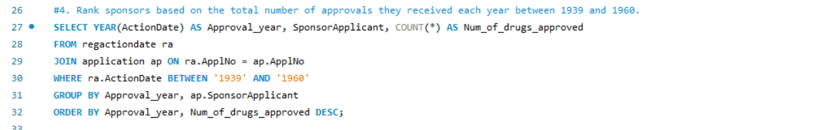
Task 1
MySQL Queries

Slide 4
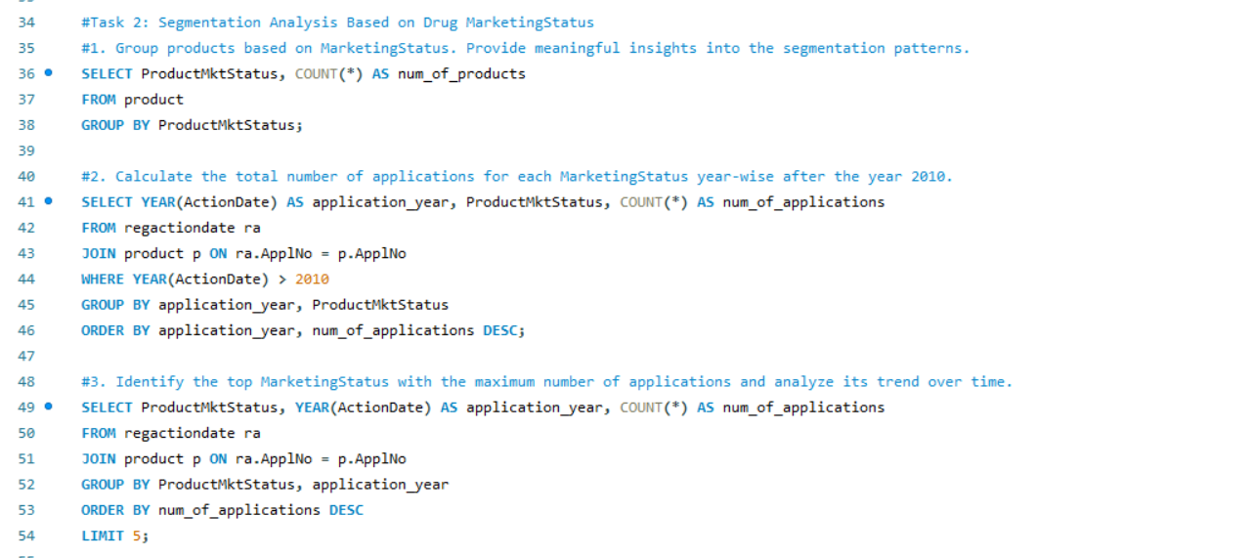
Task 2

Slide 5
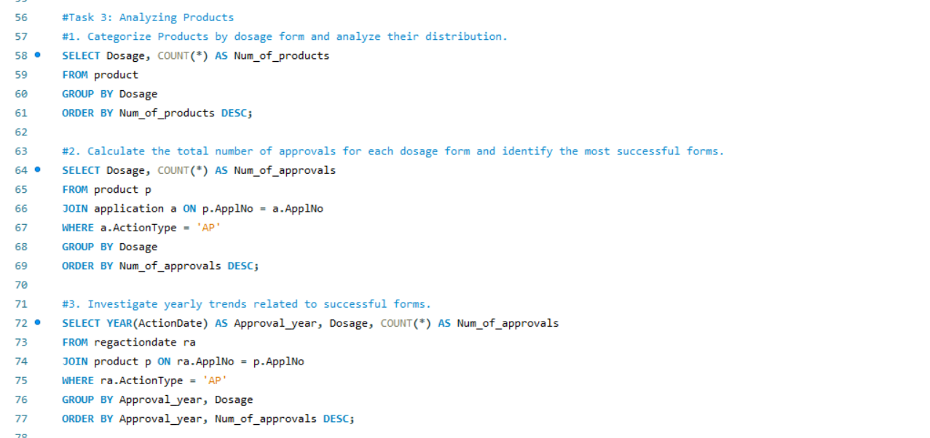
Task 3

Slide 6
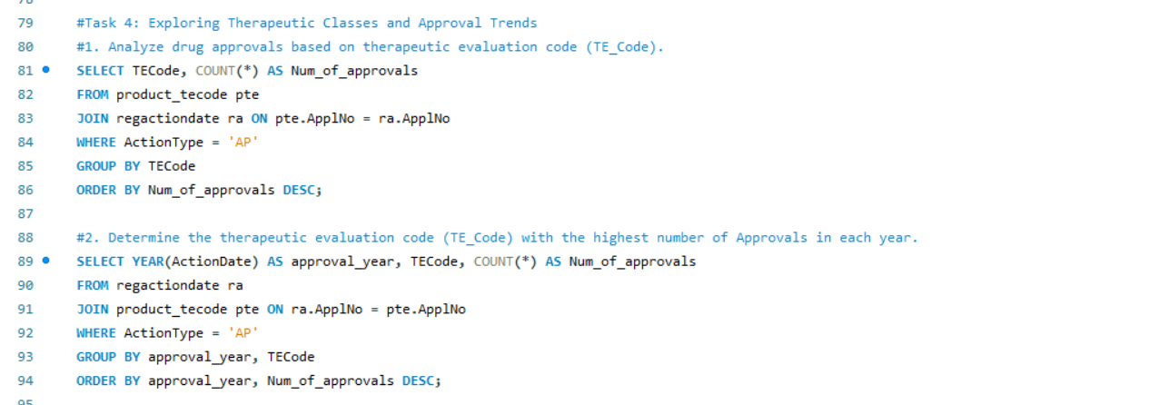
Task 4

Slide 7
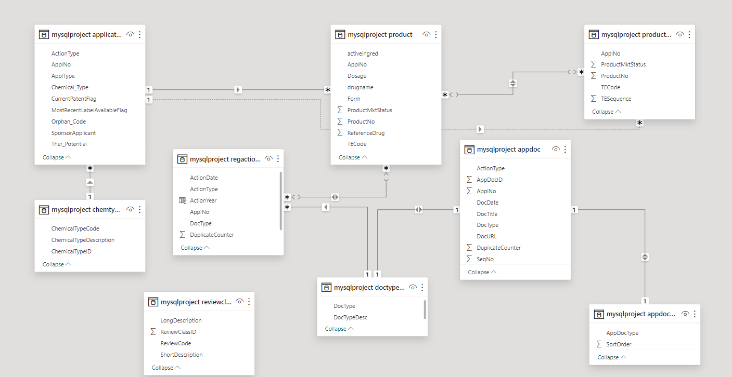
Power BI Model View

Slide 8
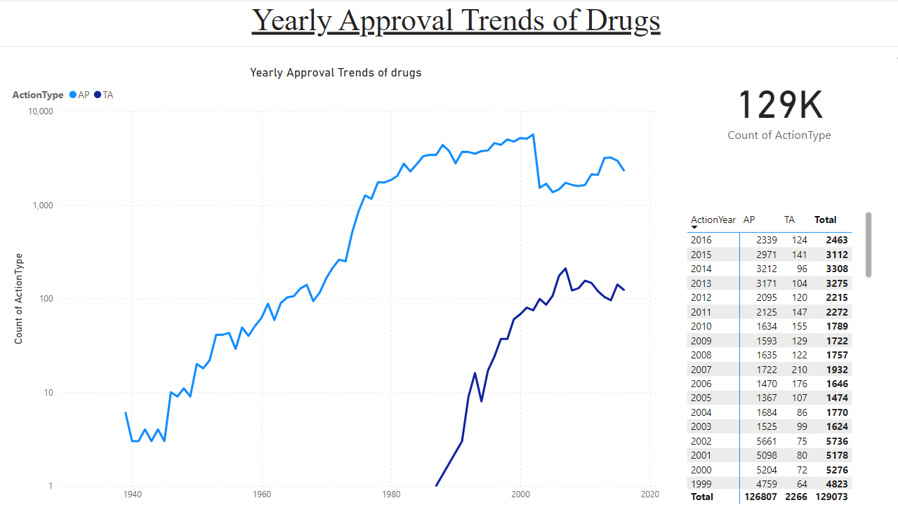
Power BI Visualizations
As per the Statistics, the approved drugs are highest in the year 2002 i.e. 5661.
The total count of Drugs is 129K from year 1939 to 2016 which includes Both AP and TA.

Slide 9
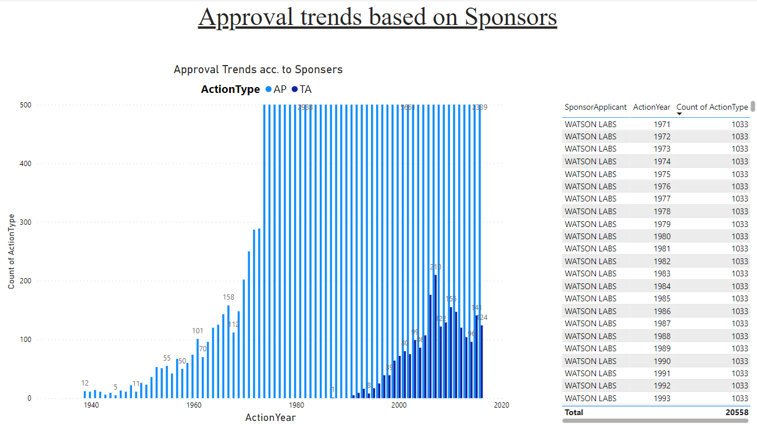
According to this chart, the most reliable and having the highest approvals over many years is WATSON LABS which gives the consistent of 1033 approvals each year followed by another sponsor SANDOZ having 636 approval each year.

Slide 10
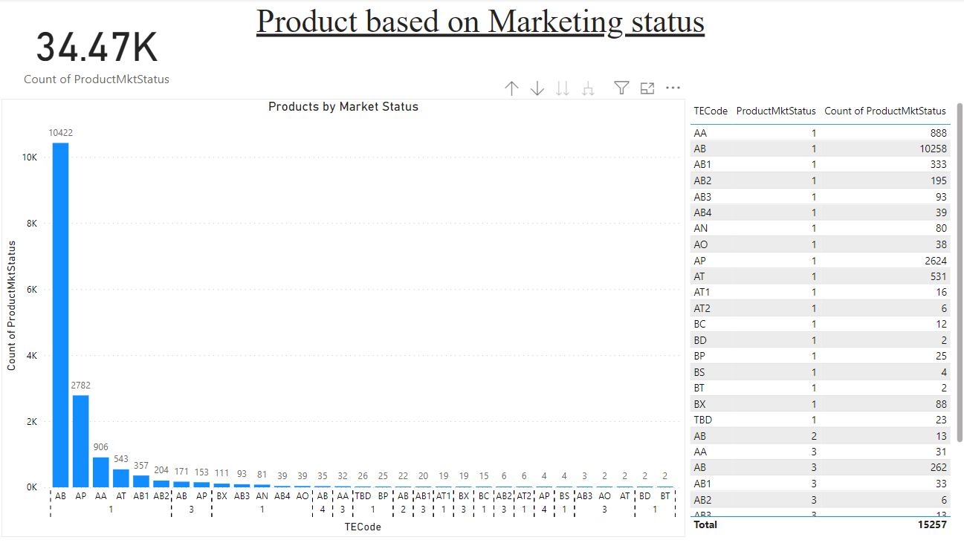
The chart shows us the different pharmaceutically equivalent products as per their Market Status.
Here the product type AB (10422) and AP(2782) have the highest numbers in Market status 1.
AB are Drug products for which actual or potential bioequivalence problems have been resolved with adequate in vivo and/or in vitro evidence supporting bioequivalence.
AP are products whose therapeutically equivalent rating is assigned as they are manufactured in accordance with Current Good Manufacturing Practice regulations and meet the other requirements of their approved applications.

Slide 11
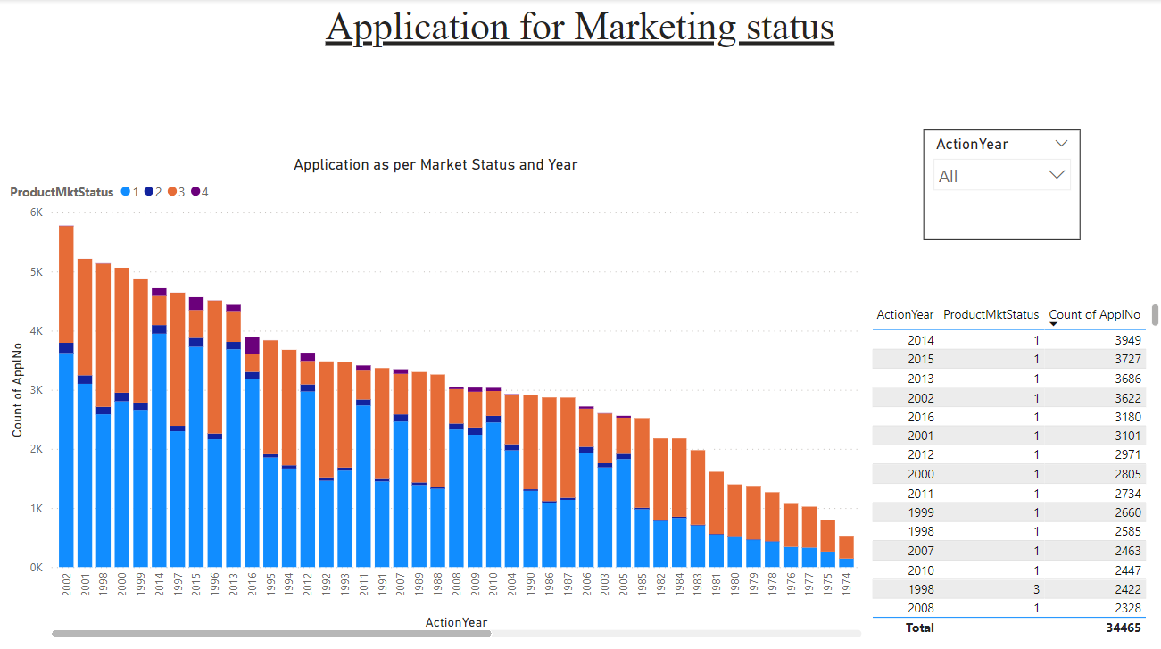
These visuals shows the number of applications for each Market status and Year.
As per the chart, year 2002 has the maximum no. of overall applications i.e. 5778 while year 2014 has the most applications in Market Status 1 i.e. 3949.

Slide 12
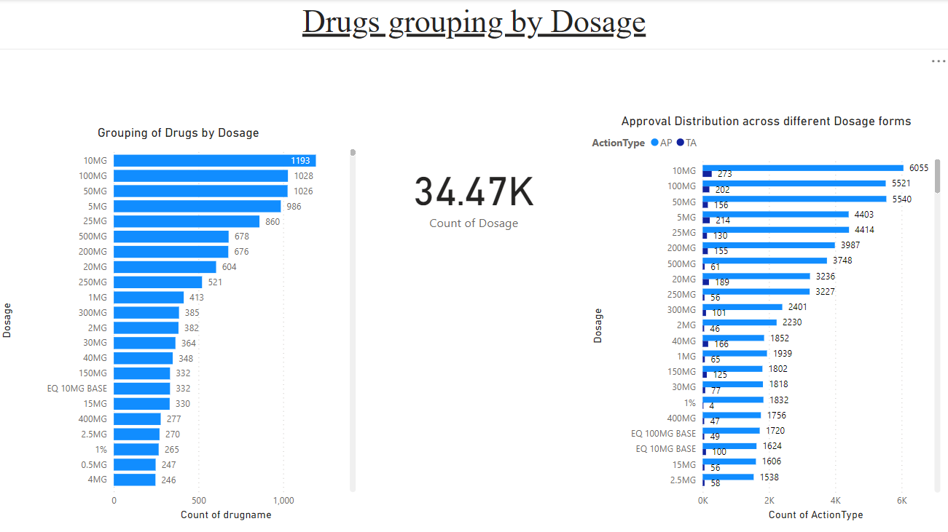
The first chart shows that maximum types of the Drugs has the dosage of 10MG i.e. 1193 followed by 100MG Dosage form with 1028 Drug types. So these two forms have the most use for customers depends on the needs.
As per the second bar chart, the maximum approval are given to the 10MG dosage form in both AP i.e. 6055 and in TA i.e. 273. The low dosage like 10MG and 50MG are most successful as maximum variety of medicines.

Slide 13
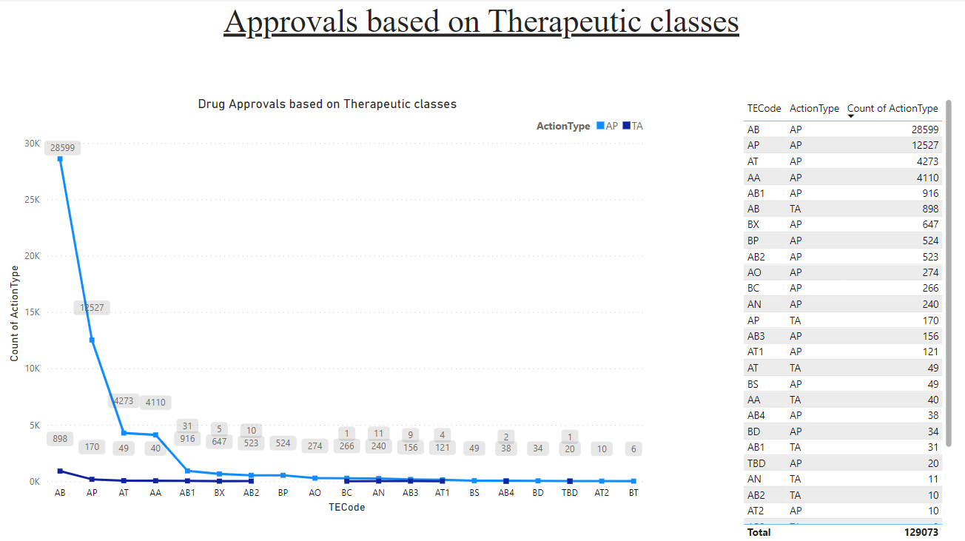
Based on the therapeutic classes chart, Drugs type AB has the highest number of approval rate i.e. 28599 followed by the Drug type AP with approvals of 12527.

Slide 14
Thank you

